Slide 1
IRB Basics
An Introduction to the UWM IRB

Slide 2
The Who, What, When, Where, Why and How of the IRB
Not necessarily in that order

Slide 3
IRB = Institutional Review Board
We are people.

Slide 4
Who makes up the IRB?
Regulations:
Minimum 5 members
Diverse in background / experience / race / gender
Scientists & non-scientists
At least one member who is not affiliated with the institution
UWM IRB:
15 members + 11 alternates
Mix of gender, race, and expertise
Faculty members
Student members
Staff members
Unaffiliated

Slide 5
IRB Office Staff
Melissa Spadanuda, IRB Manager
414-229-3173 / spadanud@uwm.edu
Melody Harries, IRB Administrator
414-229-3182 / harries@uwm.edu
Leah Stoiber, IRB Administrator
414-229-7455 / lstoiber@uwm.edu
General IRB questions: irbinfo@uwm.edu
University Safety & Assurances
Engelmann Hall 270
PO Box 413
Milwaukee, WI 53201
uwm.edu/irb

Slide 6
Why does the IRB exist?
Rules governing human subjects research before the 20th century:

Slide 8

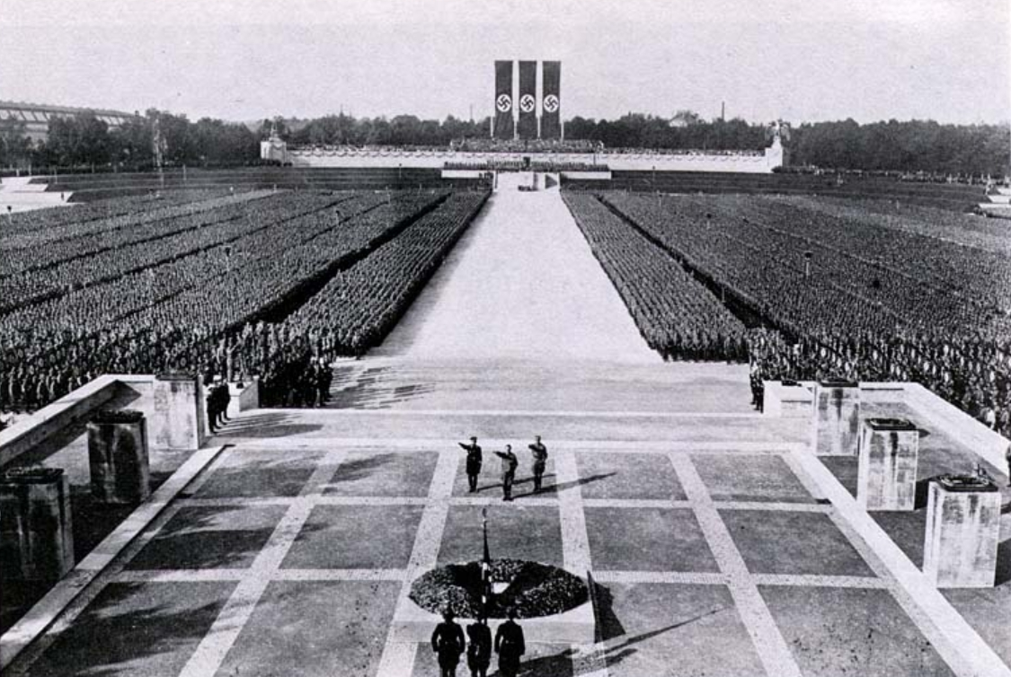
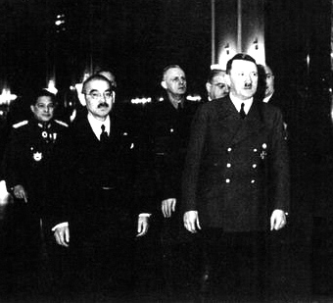
Why does the IRB exist?

Slide 9
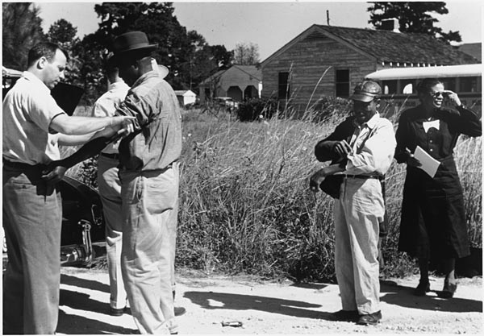

Why does the IRB exist?
Tuskegee Syphilis study (1932-1972)
Willowbrook School studies
http://www.archives.gov/atlanta/exhibit/popups.php?p=6.1.10

Slide 10
Why does the IRB exist?
San Quentin prison studies (1913-1951)
Stuttering experiment in orphans (1939)
Guatemala studies on prisoners, prostitutes and soldiers (1946-1948)
Stanley Milgram: Obedience to Authority (1960s)
Tearoom Trade study (1960s)
Stanford prison experiment (1971)
Havasupai tribe genetic research (1990s)
Jesse Gelsinger gene therapy study (1999)
Dan Markingson suicide (2004)
Newborn blood spots controversy (2011)
Facebook mood manipulation (2012)

Slide 11
Why does the IRB exist?
Nazi Germany Nuremburg Code (1949)
Tuskegee Syphilis study, Willowbrook School studies, and others The Belmont report (1978)
Federal policy for the protection of human subjects, 45 CFR 46 (1981)
Rules and framework for conducting ethical research on human subjects in the US.
Established the IRB review system

Slide 12
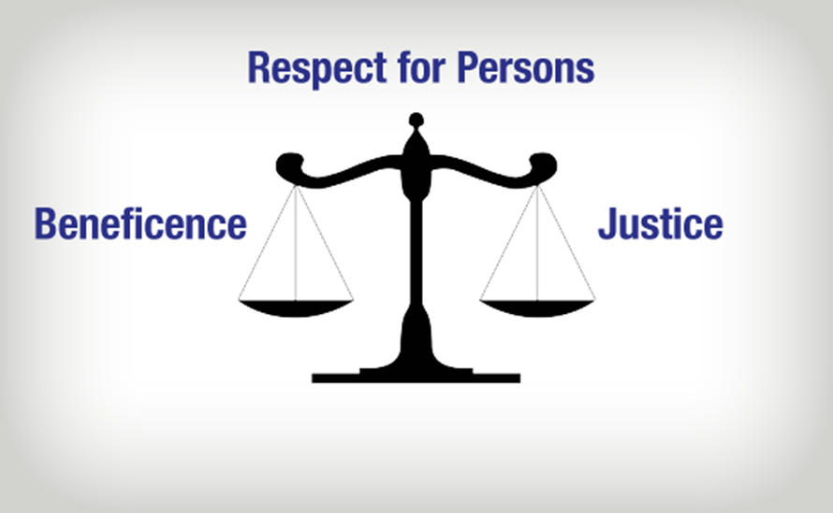
The Belmont Principles
Image: http://www.northeastern.edu/research/hsrp/irb/belmont-report/

Slide 13
What does the IRB do?
Reviews all human subjects research conducted by UWM faculty, staff and students.
Ensures compliance with ethical guidelines, federal and state regulations, and university policies.
Our ultimate goal and purpose is to protect the rights, safety and welfare of human research subjects.

Slide 14
The Belmont Principles
Image: http://www.northeastern.edu/research/hsrp/irb/belmont-report/

Slide 15
IRB Criteria for approval
Risks to subjects are minimized.
Risks are reasonable in relation to anticipated benefits.
Selection of subjects is equitable.
Informed consent will be sought from each prospective subject or their legally authorized representative.
When appropriate, the research plan makes adequate provision for:
monitoring the data to ensure the safety of subjects
protecting the privacy of subjects
maintaining the confidentiality of the data
Additional safeguards are in place when some or all subjects are likely to be vulnerable to coercion or undue influence.
- 45 CFR 46.111, paraphrased

Slide 16
Informed Consent
Recruitment
Signing Consent form
Study procedures
End of study
Explaining Study

Slide 17
Informed Consent Document
Consider your audience
Write in a conversational tone
Question / answer format
Use pronouns (I, you, we)
Use contractions (don’t, we’re, you’ll)
No walls of text
Utilize Use the simplest form of a verb
Bullet points, tables, diagrams, pictures

Slide 18
How does the IRB review studies?
Minimal risk (definition) 45 CFR 46.201(i):
“[…] the probability and magnitude of harm or discomfort anticipated in the research are not greater in and of themselves than those ordinarily encountered in daily life or during the performance of routine physical or psychological examinations or tests.”

Slide 19
How does the IRB review studies?
Full board studies (more than minimal risk):
New devices
Extremely sensitive topics
Spiders
~ 5-10 studies per year
Expedited studies
Exempt studies

Slide 20
How does the IRB review studies?
Full board studies
Expedited studies (minimal risk and meet certain criteria):
Questionnaires, surveys, and interviews where participants are identifiable and/or topics are somewhat sensitive
Non-invasive measurements
Cognitive tests
~ 125-175 studies per year
Exempt studies

Slide 21
How does the IRB review studies?
Full board studies
Expedited studies
Exempt studies (minimal / no risk and meet certain criteria):
Research on educational practices
Anonymous questionnaires, surveys and interviews where topics are not sensitive
~ 200-250 studies per year

Slide 22

When does the IRB review studies?
Full board
IRB meets the first Friday of each month
Can approve as-is, approve with conditions, table, or disapprove
Allow a minimum of 2 months for review
Expedited
IRB office staff initial review – within 1 week (usually 2-3 days)
Primary reviewer – 2 weeks
Revisions are requested or approval is issued
Allow a minimum of 4-6 weeks
Exempt
IRB office staff review – within 1 week (usually 2-3 days)
Revisions are requested or approval is issued
Allow a minimum of 2-3 weeks

Slide 23
So you want to do research…

Slide 24
Step 1: Is it Human Subjects Research?
Must meet 2 criteria:
A systematic investigation designed to develop or contribute to generalizable knowledge
Involves human subjects: a living individual about whom an investigator obtains a) data through intervention or interaction with the individual, or b) identifiable private information

Slide 25
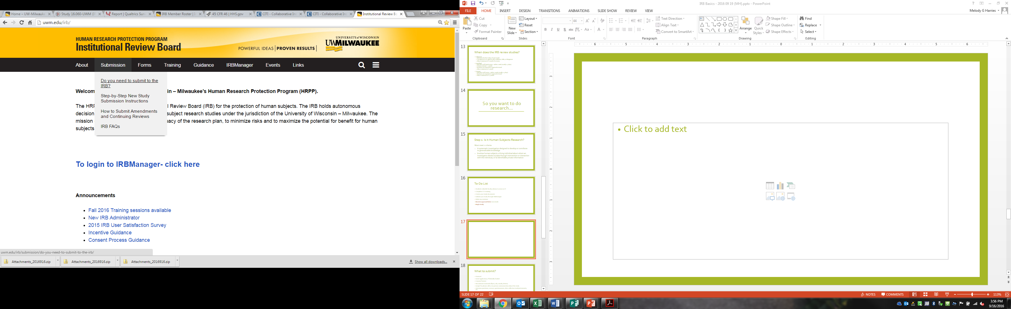
Step 1: Is it Human Subjects Research?
*Also used to determine if you’re “engaged” in research

Slide 26

To-Do List
Students: identify faculty advisor to serve as PI
Complete CITI training
Create your study documents
Submit your study through IRBManager
Make any revisions
Receive approval letter (via email)
Begin study

Slide 27
What to submit?
Protocol
Grant application, if federally funded
Consent form(s)
Recruitment materials (flyers, ads, emails, letters)
Scripts for phone calls or in-person communication about the study
Interview questions, surveys, questionnaires, data collection tools/instruments, etc.
Thank you notes to subjects
If a subject will see or hear it, submit it!

Slide 28

Special Considerations
HIPAA
FERPA
Raffles as incentives
Radiation of any type (DEXA scans)
Blood or other biological samples
Deferrals with other institutions
International research

Slide 29

Tips for quicker reviews
Principal Investigator (PI) vs. Student Principal Investigator (SPI)
Ensure all documents are consistent
Describe your study thoroughly and completely
Describe how you are qualified to do the intervention(s)
If you are using devices or equipment, provide specific names and details
Have someone unfamiliar with your research review the submission
If we can’t understand what you are doing, we can’t approve your study.

Slide 30
Once you have approval…

Slide 31

Post-approval submissions
If you need to change your study: Amendment
Expedited and Full Board studies: Annual Continuing Reviews
Problems with the research: Reportable Event
Unexpected problems
Noncompliance: General, Serious, or Continuing

Slide 32
When in doubt, call or email
irbinfo@uwm.edu
414-229-3173 / 414-229-3182 / 414-229-7455
We’re happy to help!

